Slide 1



STUDIO SHODWE
PAGE 01
Image
Caption Generator
Machine Learning

Slide 2
STUDIO SHODWE
PAGE 02
Group
Members
Muhammad Abdullah 22-NTU-CS-1358
Muhammad Kaif 22-NTU-CS-1364
Maryam Sameen 22-NTU-CS-1354
Machine Learning

Slide 3

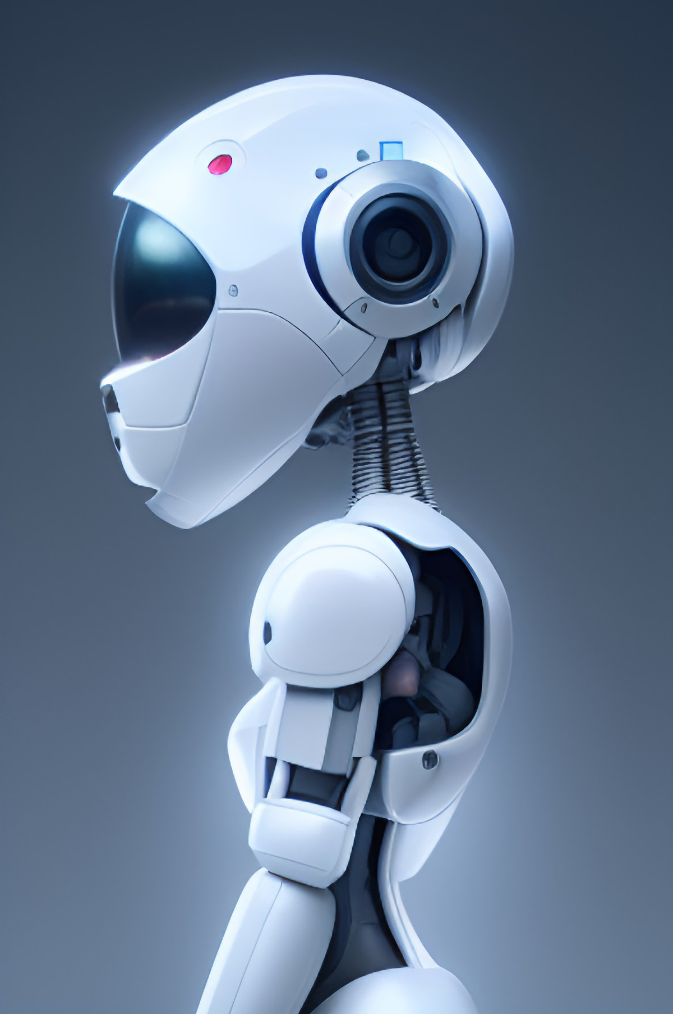
STUDIO SHODWE
PAGE 03
Image caption generator is an interactive web application that generates natural language captions for images.
1.
Intro
duction
2.
It uses deep learning with a CNN encoder and LSTM decoder.
3.
The system is trained on a dataset of images and corresponding textual descriptions.
Machine Learning

Slide 4
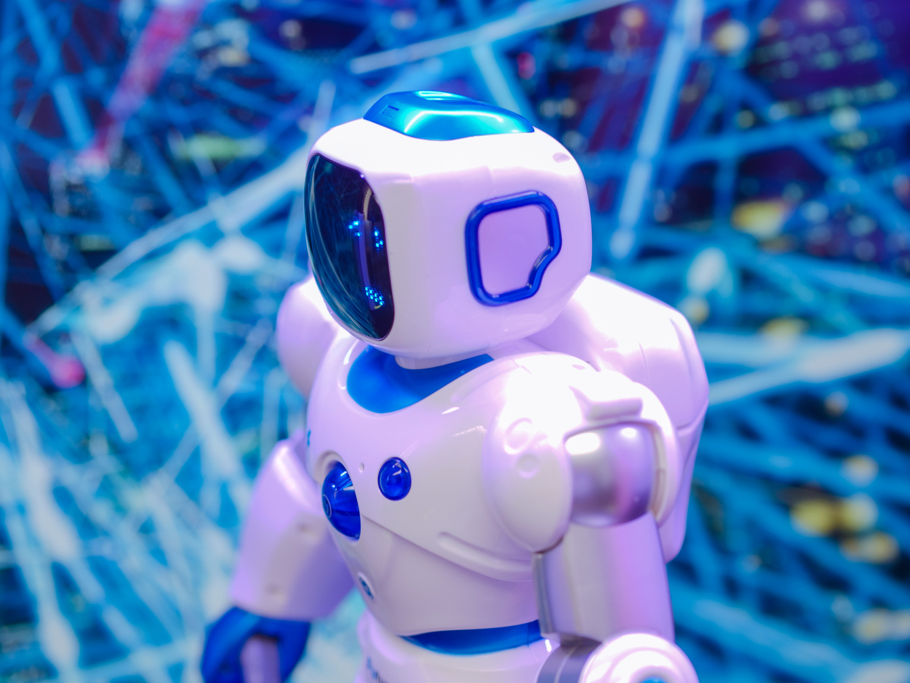

STUDIO SHODWE
PAGE 04
Problem
Statement
Understanding and describing images is a core task in computer vision and AI.
The goal is to develop a model that can generate accurate captions for unseen images.
Machine Learning

Slide 5
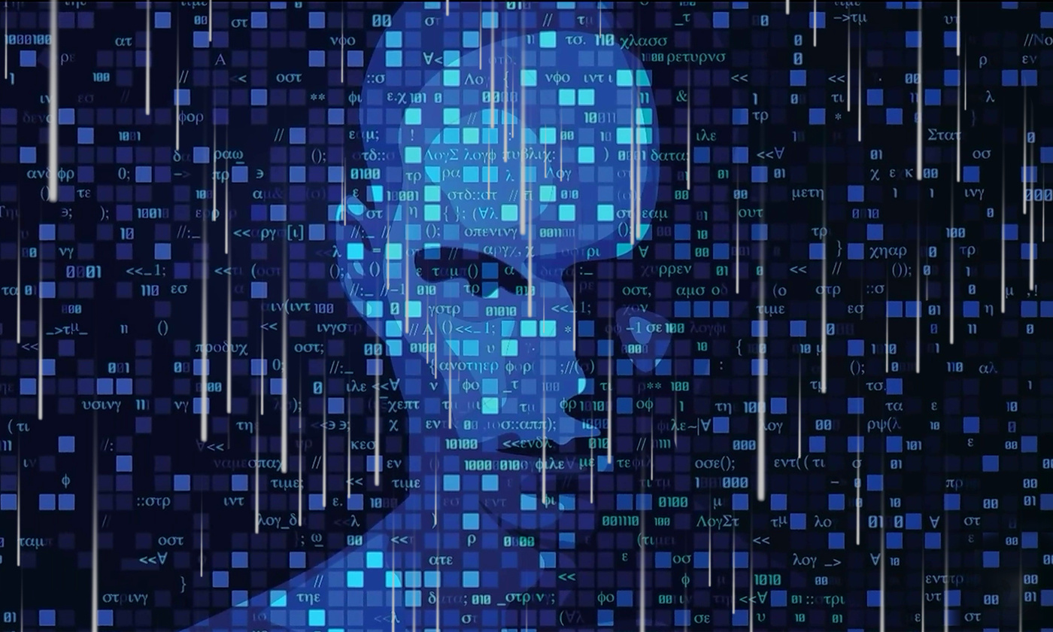
STUDIO SHODWE
PAGE 05
Dataset
Used
Image captions are saved using an image_captions.txt file
Features are pre-extracted and stored in image_features.pkl using InceptionV3.
Captions tokenized and max length computed for consistent input.
Machine Learning

Slide 6
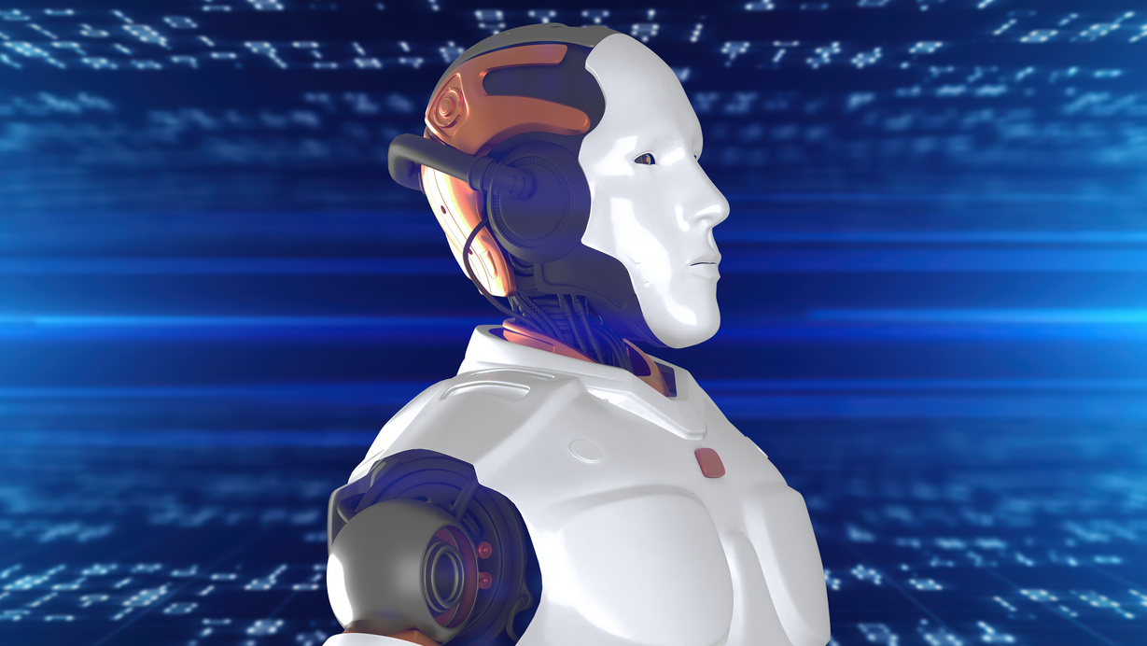
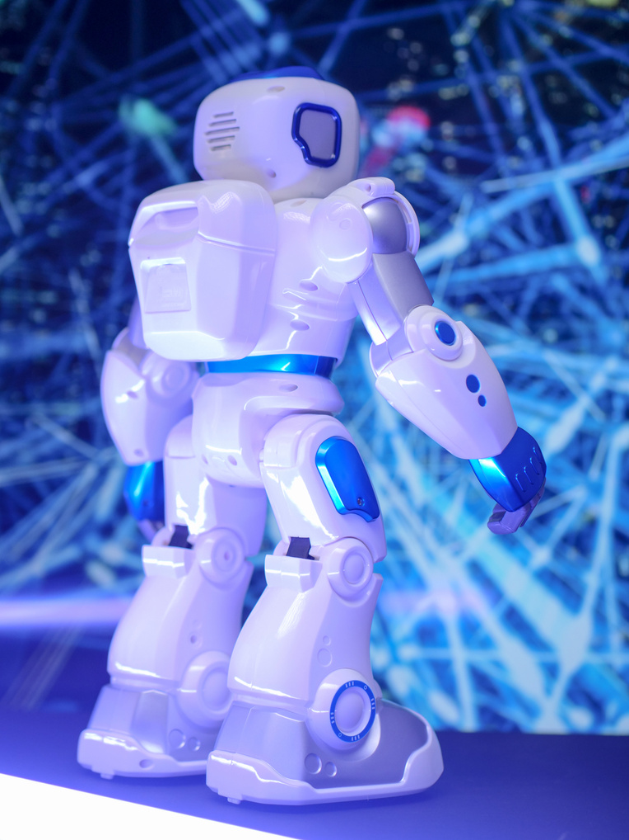
STUDIO SHODWE
PAGE 06
Model
Architecture
CNN encoder (InceptionV3) extracts images features.
LSTM Decoder generates captions from image embeddings.
Uses word embeddings, attention mechanism (if added), and max sequence padding.
Machine Learning

Slide 7





STUDIO SHODWE
PAGE 07
Training &
Tools
1.
Python
2.
Tensorflow
3.
4.
Numpy
Pillow
Machine Learning

Slide 8
STUDIO SHODWE
PAGE 08
Flask
Web App
Flask backend serves the model and accepts images from users.
1.
HTML and CSS is used for clean and user-friendly templates.
2.
Generates and displays captions using the trained model
3.
Machine Learning

Slide 9
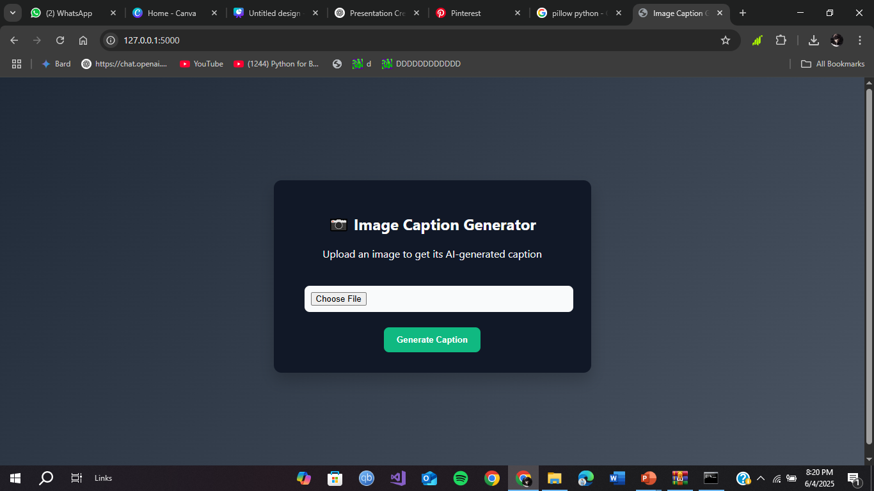
PAGE 09
User
Interface
Machine Learning

Slide 10
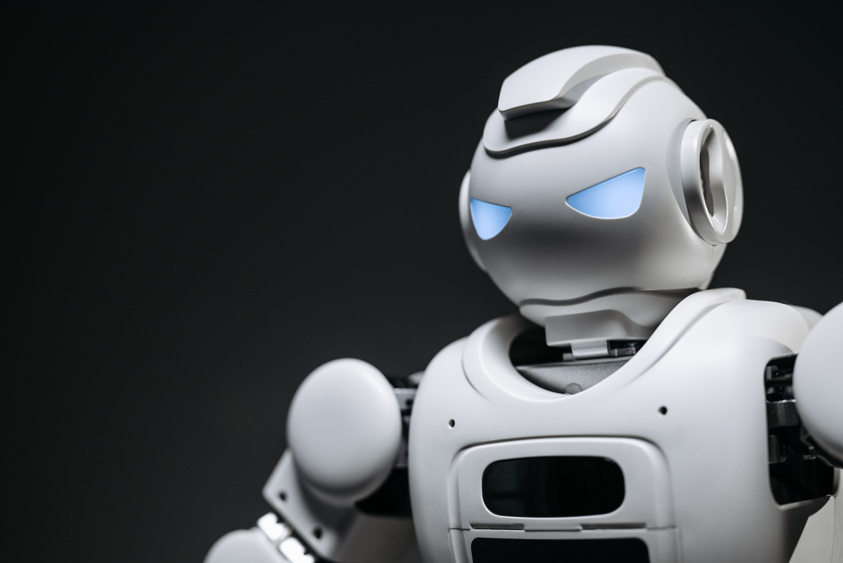
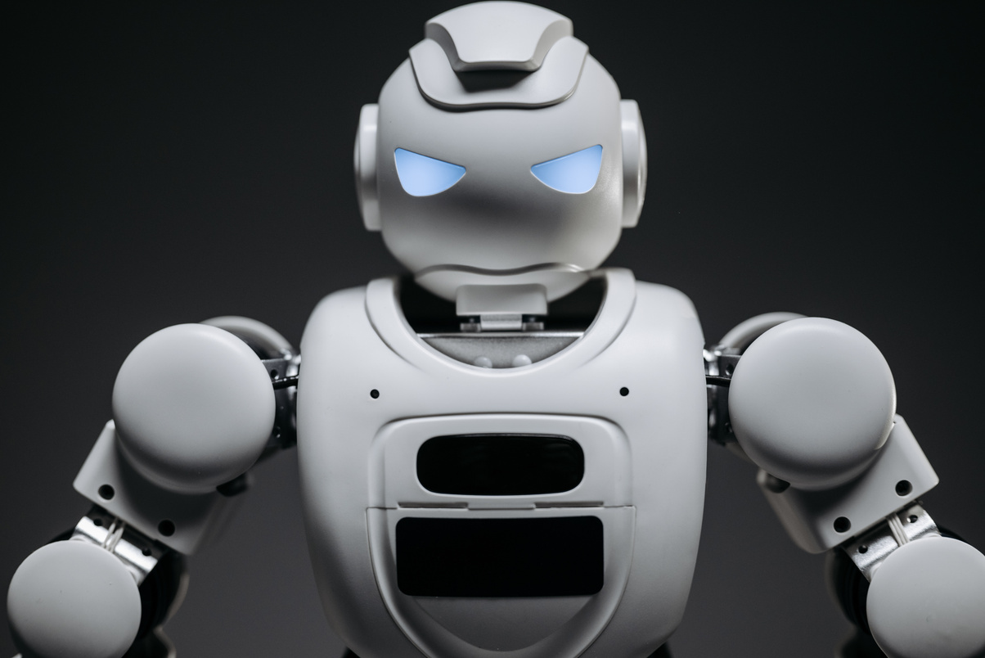
STUDIO SHODWE
PAGE 11
FUTURE
PROSPECTS
Multi-language aspects: Translate captions into different languages using NLP APIs.
Real time mobile application: Use Tensorflow Lite to deploy the model on mobile devices.
Enhanced Visual Understanding: Integrate object detection to improve contextual accuracy of captions.
Machine Learning

Slide 11
PAGE 12
STUDIO SHODWE
THANK
YOU!
Machine Learning

